Slide 1




Macrosystems EDDIE: Using Ecological Forecasts to Guide Decision Making
Woelmer, W.M., T.N. Moore, R.Q. Thomas, and C.C. Carey. 25 August 2022.
Macrosystems EDDIE: Using Ecological Forecasts to Guide Decision Making
Macrosystems EDDIE Module 8, Version 2.
https://serc.carleton.edu/eddie/macrosystems/module8.
Module development was supported by NSF grants DEB-1926050 and DBI-1922016.
Notes:
Welcome the students to class. It might be helpful to go around the room and briefly discuss if anyone has experience with ecological forecasting, forecast user analysis, or science communication. The point of this is to emphasize that most students are likely novices, and that asking lots of questions is ok because their peers are novices as well.
It is really important at this point to emphasize that there will be lots of new material covered during this module, and that going slowly and asking for help is very much encouraged!

Slide 2

Plan for today:
Short overview on ecological forecasting, how ecological forecasts are used, and how we can use visualizations of forecasts to improve decision-making!
Activity A: Explore ecological forecast visualizations
Activity B: Make decisions using forecast visualizations
Activity C: Create a customized visualization for a specific user
Pixabay
Notes:
Quick road map of what will be covered in the PowerPoint. We will briefly go over topics related to ecological forecasting, how ecological forecasts are used, and how we can use visualizations of forecasts to improve decision-making.
Briefly go over the three activities

Slide 3
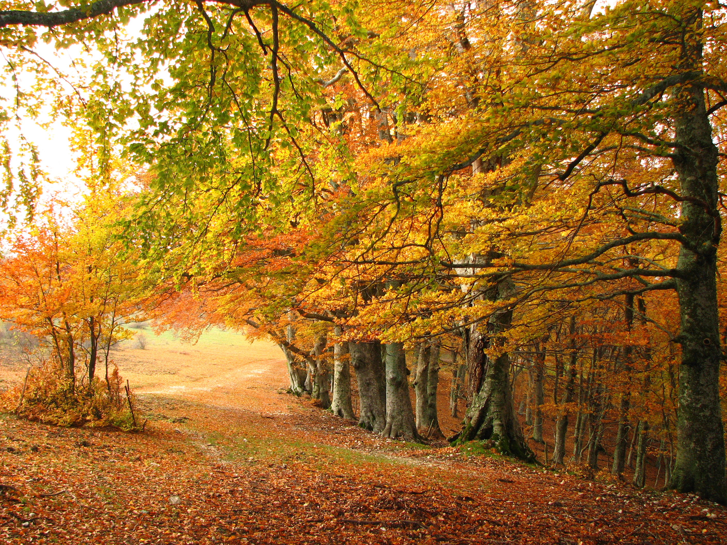
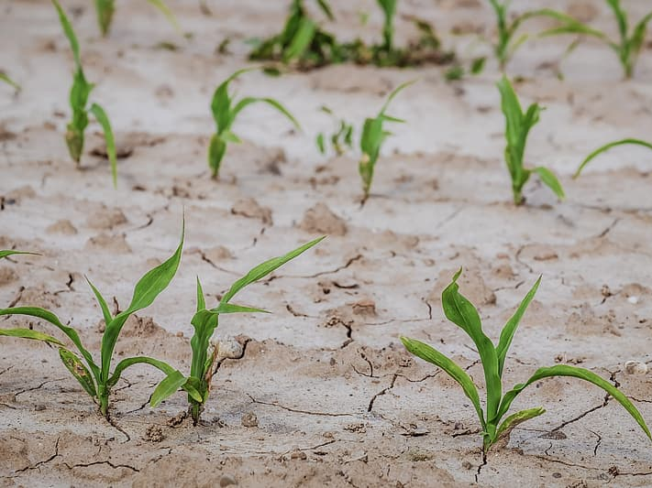
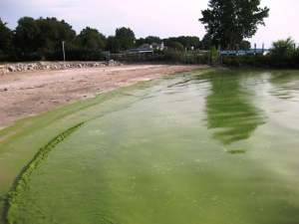
Why are forecasts made?
Ecosystem variability is changing worldwide as a result of human pressures (e.g., climate and land use change)
Because of this, ecological forecasts are critical for:
Improving scientific understanding of ecological processes
Aiding in natural resource management
Enhancing the ability of the public to make decisions regarding natural resources
Wikimedia commons
Pikrepo
NOAA
Notes:
To start today, let’s begin by thinking about why forecasts are made. As a result of numerous human impacts on ecosystems, historical conditions are no longer good indicators of how ecosystems will change in the future. Because of this ecological forecasts are critical for a number of reasons. They improve scientific understanding of ecological processes, aid in natural resource management, and enhance the ability of the public to make decisions regarding how they respond to and interact with natural resources

Slide 4
What is a Forecast?
“A forecast is a prediction of a future event
with uncertainty”
Events have not yet occurred
Gives a probability or a likelihood of the event to occur (uncertainty)
Actionable
Notes:
But what do we mean when we talk about ‘forecasts’ and what is a ‘forecast’ actually? For the purpose of today’s lecture, a forecast is a prediction of a future event with uncertainty. This means that a forecast must be for an event which has not yet occurred, it must give a probability or likelihood of the event to occur (this is the uncertainty), and it should be actionable, meaning that it can inform some decision in order for someone to respond or adapt to the forecast.
What are some examples of forecasts you have encountered in your lives (e.g. weather, disease, economic, elections)

Slide 5
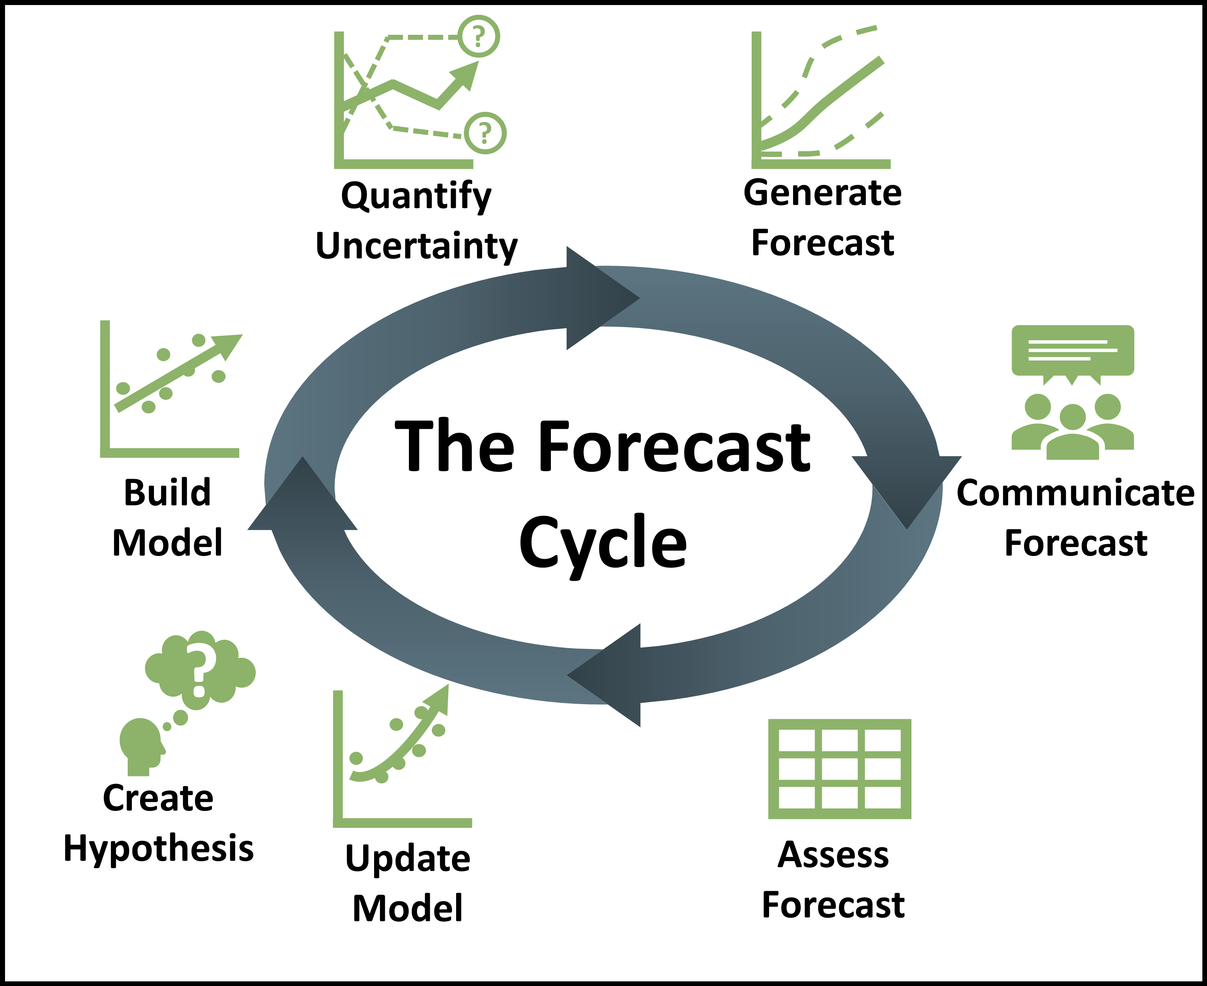
Ecological forecasts are a powerful tool for predicting ecological change
Ecological forecasts are inherently tied to decision-making as decisions are about the future!
Consequently, forecast communication is important to facilitating proper decision-making
Notes:
When we think of ecological forecasts, it is important to think of them as being made within an iterative forecast cycle. This means that forecasts are made not just once, but many times e.g. daily, allowing improvements with each iteration.
Because of this, they are a powerful tool for predicting ecological change. They allow you to start with a hypothesis about how you think an ecological variable will change, you build a model using this hypothesis, and quantify uncertainty around your prediction, and you produce a forecast. You then communicate your forecast to people who need it for decision-making, assess how well your forecast did, and then make updates and improvements before you start the cycle over.
Importantly, forecasts are inherently tied to decision-making as decisions are always about the future!
As a result, we are focusing today on the communication component of the forecast cycle, which is critical to facilitating proper decision-making

Slide 6
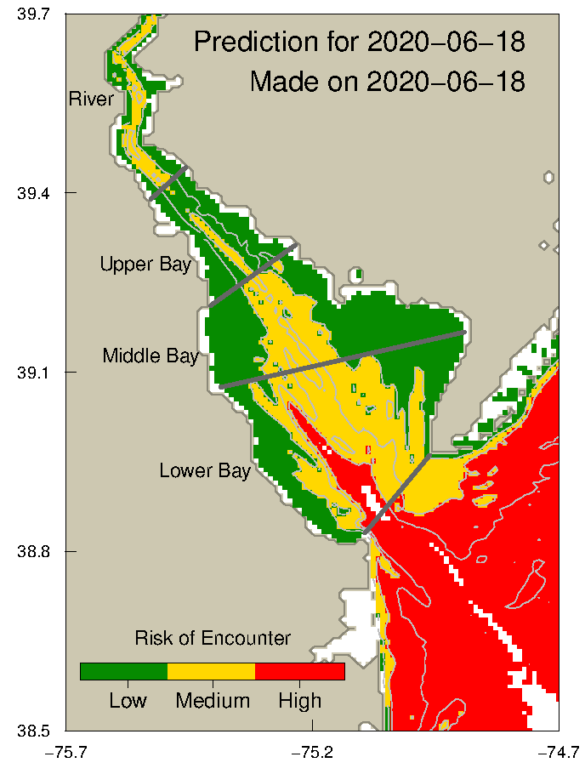
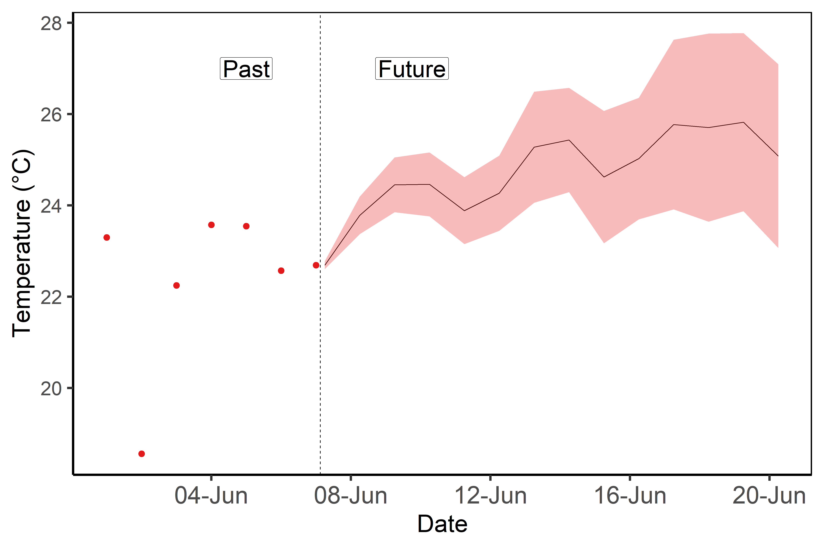
There are many different types of forecasts
“A forecast is a prediction of a future event with uncertainty”
Forecast of Risk of Endangered Marine Species Encounter
Forecast of Lake Water Temperature
Source: NOAA Atlantic Sturgeon Risk of Encounter, Breece et al. 2017
Notes:
Ecological forecasts have a lot of diversity.
Here we are seeing a forecast of water temperature for multiple days in the future at one location, where the black line shows the mean of the forecast and the uncertainty is represented by the pink area. Here is an example of another ecological forecast showing the risk of encountering an endangered species for one day in the future at multiple locations
There is a lot of variation in ecological forecasts, ranging from what variable is being predicted, how many locations it’s being predicted in, and how it’s being presented, among many other differences.

Slide 7
What other types of forecasts could you use?
Notes:
OPTIONAL class engagement slide, could be ecological forecasts specifically or other forecasts including weather, economic, political, sports, etc.

Slide 8

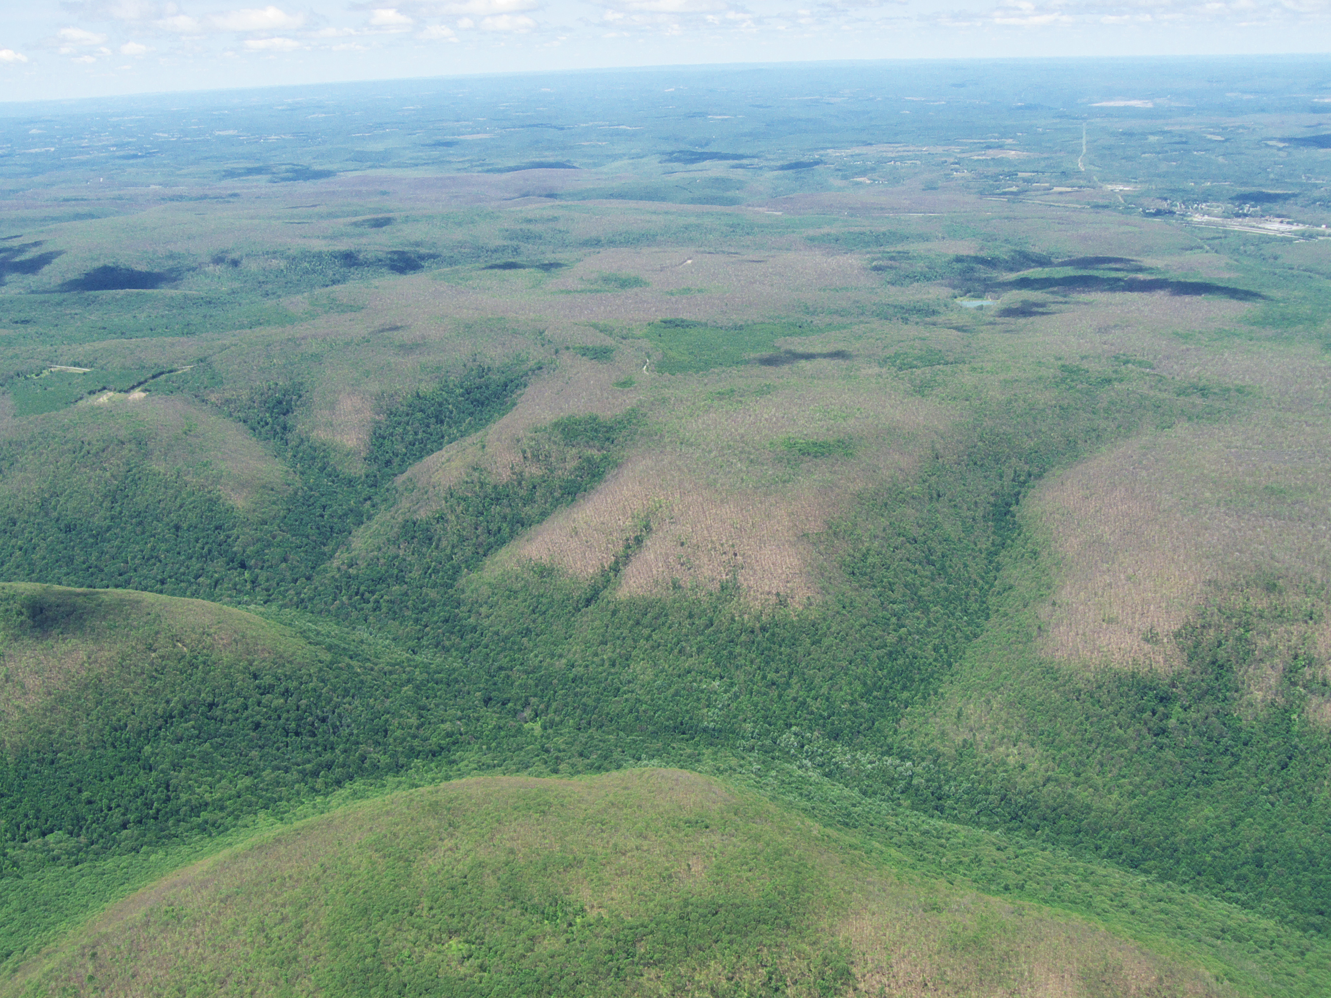
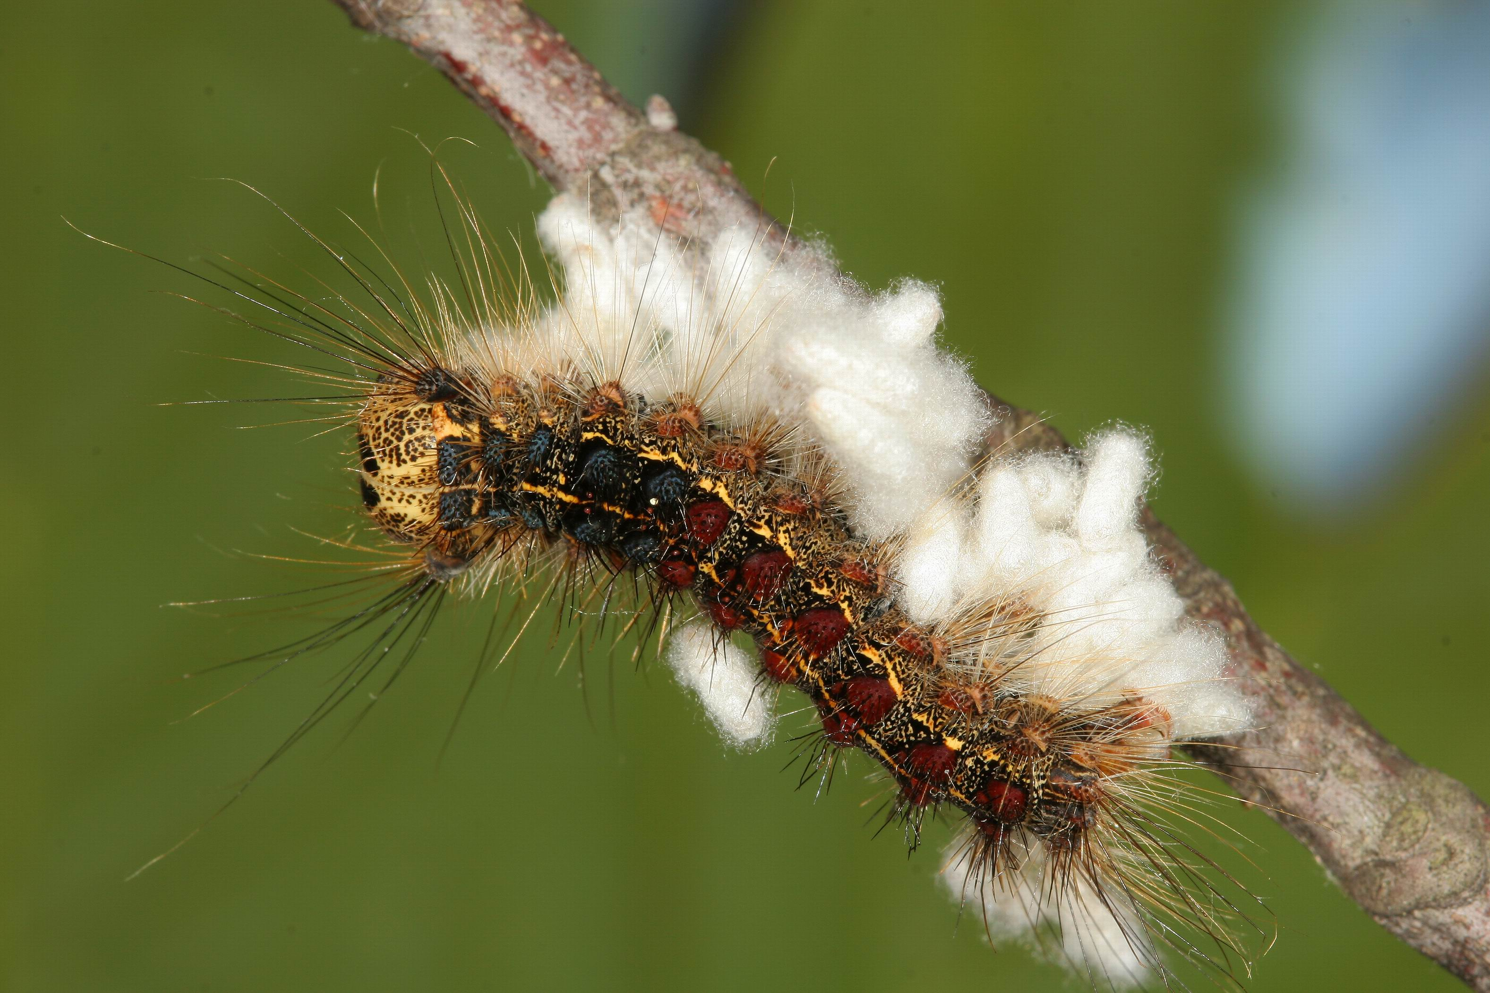
Who uses ecological forecasts?
A forecast user is anyone who can use a forecast to gain understanding or to make a decision
A forecast of invasive Spongy Moth distribution might have forecast users such as:
Scientists studying oak tree populations
Department of Natural Resources wildlife manager
Small landscaping business owner
Homeowners
Park visitors
Insect enthusiast
Among others!
PikRepo
Wikimedia Commons
Notes:
There are many different types of people, or forecast users, who can use forecasts to aid in their decision-making. More specifically, we can define a forecast user as anyone who can use a forecast to gain understanding or to make a decision.
This can range from natural resources managers to scientists to someone in the general public who is interested in learning more about a specific ecological variable. Forecasts are often made about ecological variables which have some value for decision-making. For example, the Spongy Moth (L. dispar) is an invasive moth which can wreak devastating havoc on the foliage of trees (seen in the picture on the bottom right). A forecast for distributions of this moth might have a number of different forecast users, each of which might need to make different decisions. These could include (see bullets above). The last example, an insect enthusiast, highlights an example where someone might not directly use the information to make a decision, but is interested in gaining more understanding of the ecological variable.

Slide 9
Forecast users have different needs for informing their decisions.
Based on these needs, we can loosely define 3 decision-use categories* of forecast users:
Casual user: do not require probabilistic forecasts
Example: Park visitor, family member
Practitioner: need overall idea of uncertainty
Example: Homeowner, landscaping business owner
Decision analyst: require detailed information on uncertainty
Example: Natural resource manager
*adapted from Raftery 2016
Notes:
And each of these different forecast user have different needs for informing the decisions they need to make. Based on these needs, we can loosely define 3 decision-use categories. The first is a casual user, who does not necessarily need detailed probabilistic forecasts in order to make their decisions. Secondly, we have practitioners, these are forecast users who need to incorporate an overall idea of uncertainty their decision-making. And lastly, we can think of decision analysts, who are forecast users who require a detailed information on uncertainty in order to make decisions.
If we go back to our invasive spongy moth example, we can map on the same forecast users to the decision-use categories. Park visitors or family members would fall under casual users because they don’t need probabilistic forecasts in order to inform their decisions. Practitioners would include homeowners or landscaping business owners who need to have an overall idea of uncertainty in order to inform their decisions. And lastly a decision analyst might be a natural resource manager, who needs to make long-lasting decisions and should consider detailed information about uncertainty.

Slide 10




Forecasts are inherently uncertain
We calculate uncertainty in our forecast by running many different model simulations
E.g., future weather isn’t known exactly, so we run the forecast using many different possible weather outcomes, and then can quantify differences among forecasts as part of overall forecast uncertainty
?
Notes:
NOTE: this slide has animations and should be first viewed/practiced in presentation mode
We calculate forecast uncertainty by running many different model simulations with slightly different conditions which we think represents the range of possible scenarios.
For example, we don’t know exactly how the weather is going to change in the future, so we run our forecast using many different possible weather outcomes, and then quantify the differences among the forecasts as part of the overall forecast uncertainty

Slide 11
What are other reasons why there is uncertainty in forecasts?
Notes:
OPTIONAL class engagement slide
Other sources of uncertainty:
-uncertainty in the processes which influence what you’re predicting (model representation)
-uncertainty in how other things driving your forecast might change (e.g., uncertainty in the tree population which spongy moths eat)
-uncertainty in what you’re actually measuring (e.g., uncertainty in being able to estimate spongy moth abundance)

Slide 12
Forecasts are inherently uncertain
As a result, we get a forecast with uncertainty, which includes many different forecast outcomes.
Here you are seeing the mean and confidence interval of all the different forecast runs
Notes:
As a result of using multiple weather forecasts we get a forecast with uncertainty, which shows the range of different forecast outcomes.
Here you are seeing the mean and confidence interval of all the different forecast runs, which is one common way to visualize uncertainty. But this type of visualization might not be best suited for all of the possible range of forecast users, who are going to need different types of information to inform their diverse decisions

Slide 13
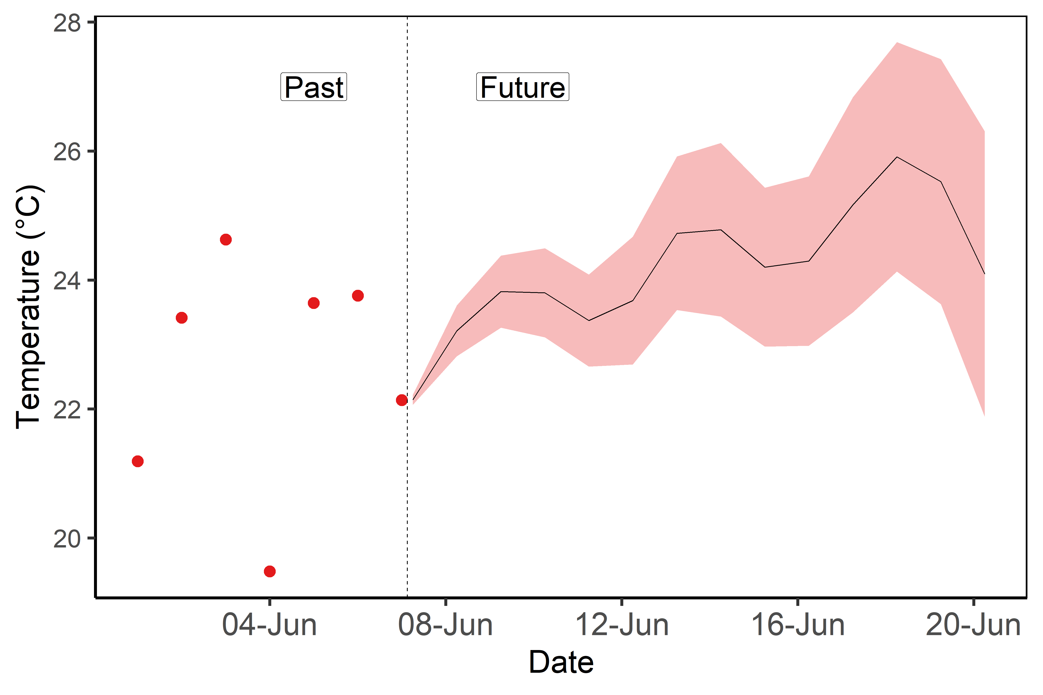
What ways can we communicate forecasts for different decision use categories?
Forecast output | Forecast index
Forecast output is the output which comes directly from the model | Forecast output that is translated into an index based on some threshold which is meaningful to decision-making
Forecast in degrees C of surface water temperature | Forecast of risk of endangered species encounter
Notes:
We can think of communicating forecast information in two broad categories. We can use the forecast output, or the numbers the model produces, and plot those values, along with some summary statistics, like the mean or median, and the 95% confidence interval.
Another way to communicate forecast output is to create an index, which is based on some threshold which has importance for decision-making. For example, the raw forecast output on the left shows the modeled temperature output, whereas the figure on the right shows an index of high likely you are to encounter an endangered species. It is important to note that the figure on the right has been translated into this index of encountering a species, while the model likely outputs information on how abundant that species is in different locations.
As a result of this ‘translation’ we can incorporate new information for the user, like how ‘risky’ it is that you will encounter this endangered species. Importantly, this allows the user to see uncertainty represented in a new way which is translated into a meaningful metric.

Slide 14
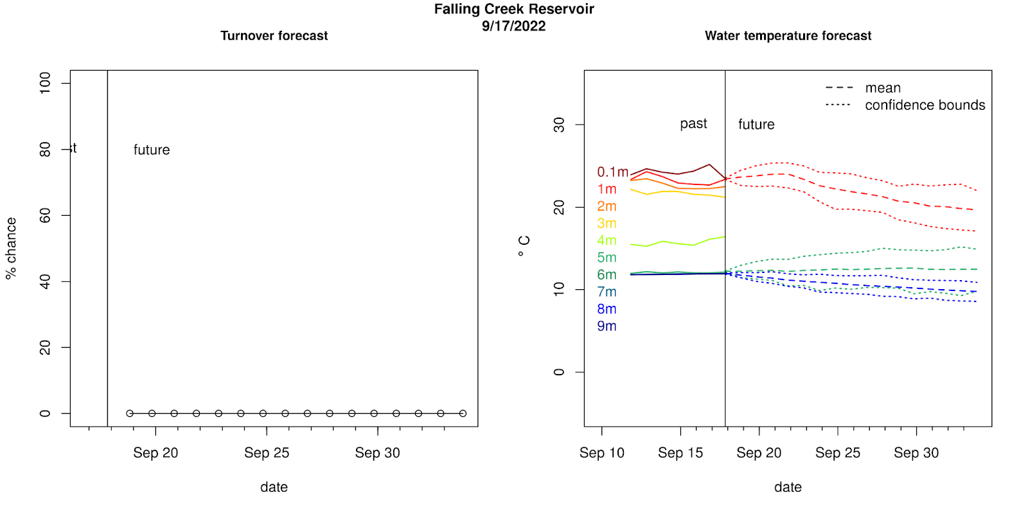
Forecast index and forecast output

Slide 15
What ways can we communicate uncertainty?
Forecast output | Forecast index
Forecast output is the output which comes directly from the model | Forecast output that is translated into an index based on some threshold which is meaningful to decision-making
Ranges of values
Confidence intervals
Probability
Risk
Suitability
Notes:
Often times, uncertainty is represented in a forecast output using something like a reported range of possible values, or a confidence interval, like we saw with the water temperature forecast. However, in a forecast index, uncertainty is often translated into a probability based on the forecast output. This may be reported as a risk-level, or suitability of a certain forecast variable. We can see an example of this in the Risk of encountering Atlantic Sturgeon forecast.
These are key words that can indicate uncertainty, but not hard and fast rule and should be interpreted

Slide 16
What ways can we communicate uncertainty?
 | Forecast output | Forecast index
Number
Word
Icon
Figure
 | Summary metric
Word | Risk level Pollen Risk: High
Number
Icon
Figure
Notes:
Between these two categories of raw forecast output and forecast indices, we can think of different types of communications, which range from using numbers, words, icons, and figures to represent uncertainty.

Slide 17
What ways can we communicate uncertainty?
 | Forecast output | Forecast index
Number | Actual value Spongy moth density: 24 individuals/km² ± 4 ind./km² | Percent likelihood 22% chance of spongy moth outbreak
Word
Icon
Figure
Notes:
We can communicate both forecast output and forecast indices using a number. For example, using our pollen forecast model, there is predicted to be 24 grains per cubic meter plus or minus 4 grains per cubic meter, indicating some uncertainty in that prediction. Similarly, we can report the same information in an index that is relevant to allergen risk, and report that there is a 22% change of high allergen severity.

Slide 18
What ways can we communicate uncertainty?
 | Forecast output | Forecast index
Number | Actual value Spongy moth density: 24 individuals/km³ ± 4 ind./km³ | Percent likelihood 22% chance of spongy moth outbreak
Word | N/A | Risk level Spongy moth outbreak risk: Low
Icon
Figure
 | Summary metric
Word | Risk level Pollen Risk: High
Number
Icon
Figure
Notes:
Because forecast output is already in the form of numbers, we can’t apply a word visualization to summarize it. However, we can translate the forecast output into an index and communicate is using words. For example, a forecast of pollen concentrations could be communicate using an Allergen Severity Index, as shown here.

Slide 19
What ways can we communicate uncertainty?
 | Forecast output | Forecast index
Number | Actual value Spongy moth density: 24 grains/m³ ± 4 grains/m³ | Percent likelihood 22% chance of spongy moth outbreak
Word | N/A | Risk level Spongy moth outbreak risk: Low
Icon | N/A | Icon represents summarized prediction; Color of the stoplight indicates a low risk of moth outbreak
Figure
Low risk of spongy moth outbreak
Notes:
Our third category of uncertainty communication is the use of an icon. Similar to a word communication, we can’t distill our forecast output into an icon, but we can use an icon to communicate an index. In this case, we use a familiar icon, a stoplight, to indicate the chance of a spongy moth outbreak. In this forecast, the risk is low, so we see the green stoplight indicated. Icons are a good way to quickly represent information without the user having to spend much time analyzing the meaning.

Slide 20

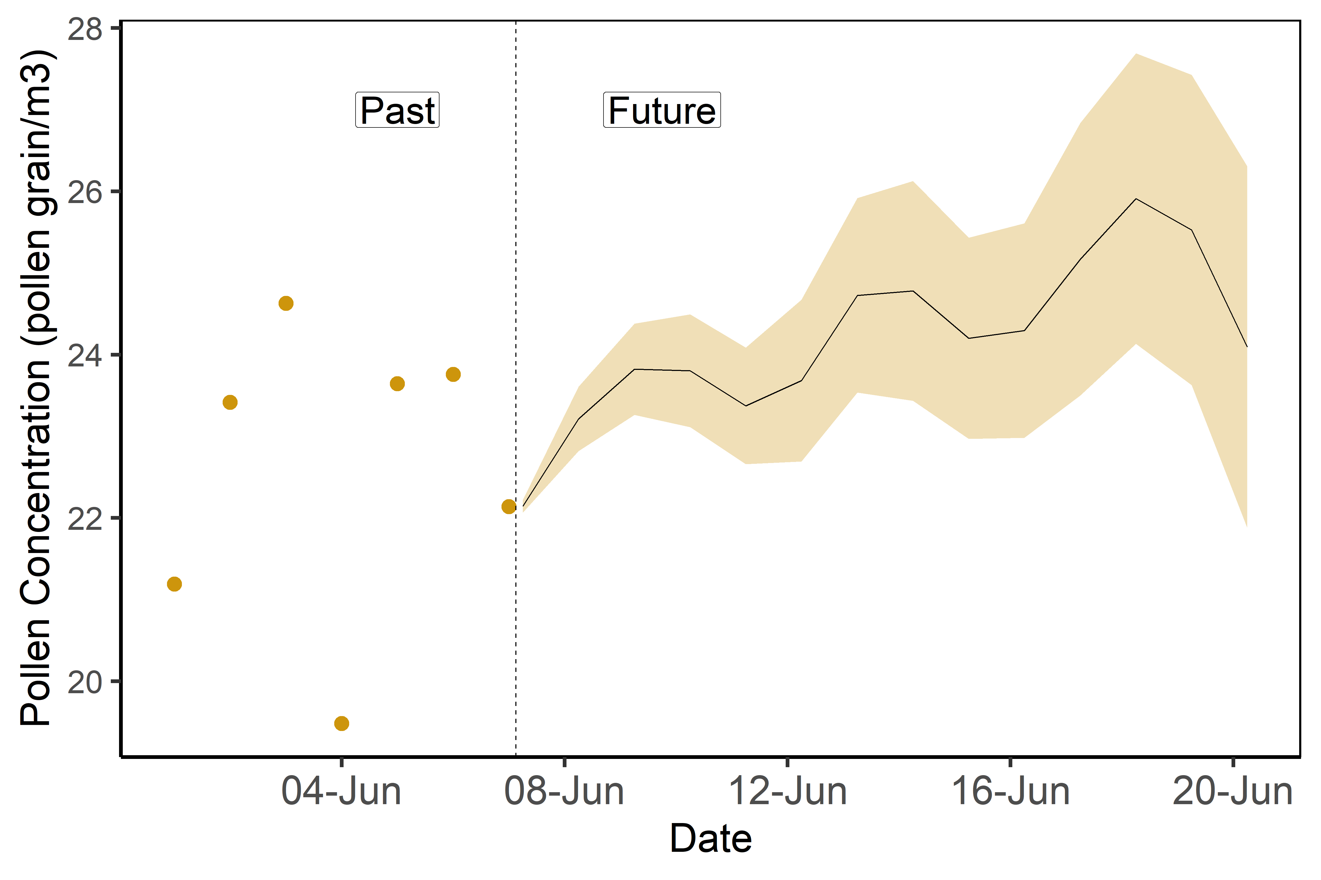
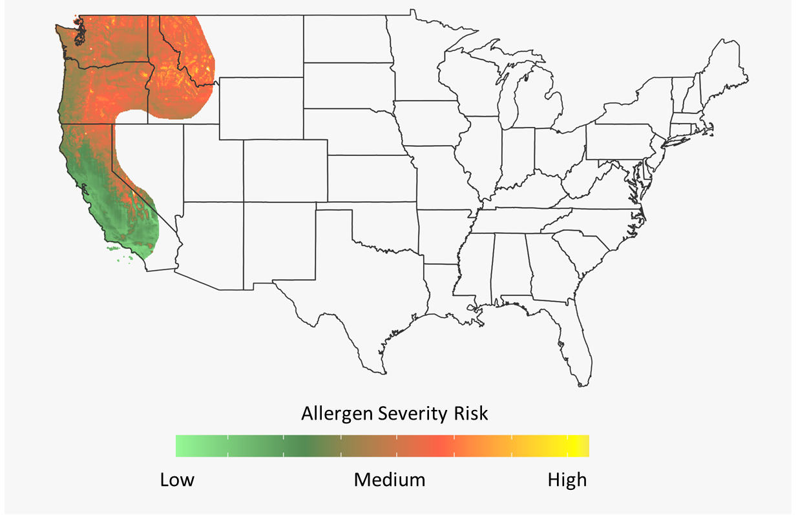
What ways can we communicate uncertainty?
 | Forecast output | Forecast index
Number | Actual value Spongy moth density: 24 grains/m³ ± 4 grains/m³ | Percent likelihood 22% chance of spongy moth outbreak
Word | N/A | Risk level Spongy moth outbreak risk: Low
Icon
Figure | Forecast of spongy moth density | Forecast of spongy moth outbreak risk
Spongy moth density (ind./km³)
Risk of Spongy Moth Outbreak
Figure modified from Harris et al. 2018
Notes:
Lastly, we can communicate uncertainty using a figure. There are many types of figures we can use to communicate uncertainty and we are just showing a few here. On the left, you can see how forecast output is plotted over time to show how spongy moth densities are predicted to change. On the right, the same data was used to convert into an index of outbreak risk and the figure shows how the predictions are expected to changed over space. Figures are a useful way to communicate a lot of information visually.

Slide 21
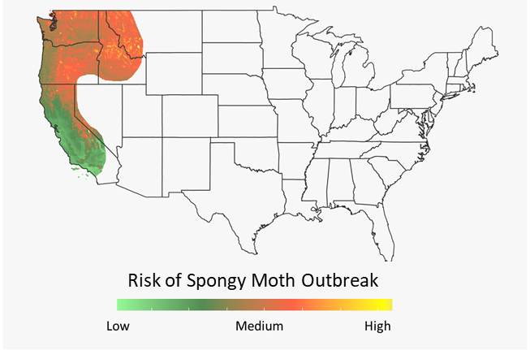
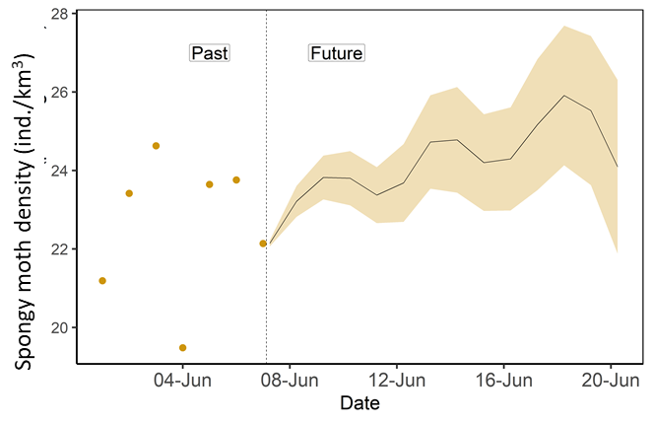
How do we visualize uncertainty for different decision use categories?
Spongy moth outbreak risk: Low
Casual user: Park visitor
Practitioner: Homeowner
Decision analyst: Natural resource manager
Notes:
And if we tie this back to our decision use categories, we can think about how we could represent uncertainty in different visualizations for each use case. While there is no perfect visualization for a single decision-use case, we can think of some general guidelines. For example, a park visitor, our casual user, might only need to know very minimal information, so we could use a word in a forecast index to say that the risk is ‘low’. A homeowner might want to know a little more about the differing levels of uncertainty and might even want to know how the uncertainty varies in different areas surrounding their home to get a bigger picture of the situation. Lastly, a natural resource manager, or our decision analyst, is going to want very detailed information about both the quantities of spongy moth and the associated uncertainties, so a forecast output which includes uncertainty might be most informative for making a detailed decision. But a natural resource manager is likely going to want this information for a number of locations, possibly the entire range of the park they are managing. So coming up with ways to represent detailed information which includes uncertainty in a map is very important but also presents some challenges.

Slide 22
Incorporating uncertainty into maps
How do we go from a forecast index in one location to a map which represents multiple locations with uncertainty?
Spongy moth density (ind./km³)
Notes:
But a natural resource manager is likely going to want this information for a number of locations, possibly the entire range of the park they are managing. So coming up with ways to represent detailed information which includes uncertainty in a map is very important but also presents some challenges.

Slide 23
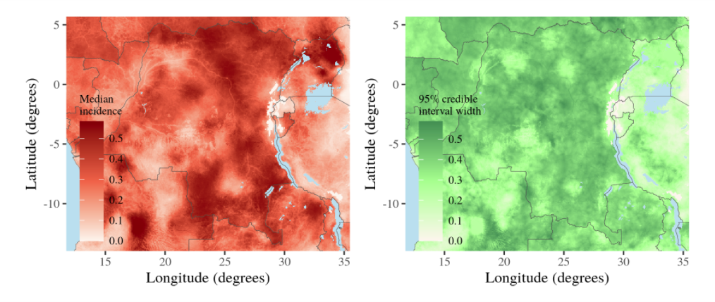
Incorporating uncertainty into maps
Separate figures
Forecast Median Confidence Interval
Side-by-side depiction of the predictive median and predictive uncertainty of Malaria prevalence in Central Africa
Figure: Thomas Pinder, Lancaster University
Notes:
One way to provide detailed uncertainty while also including detailed forecast output is to use two separate figures, one showing the forecast output and one mapping the forecast uncertainty, here as a confidence interval. This figure here shows both the forecast median on the left, and the 95% confidence interval, representing uncertainty, on the right of a forecast of Malaria prevalence in Central Africa. Importantly, the figure on the left if shown alone, does not represent any uncertainty.

Slide 24
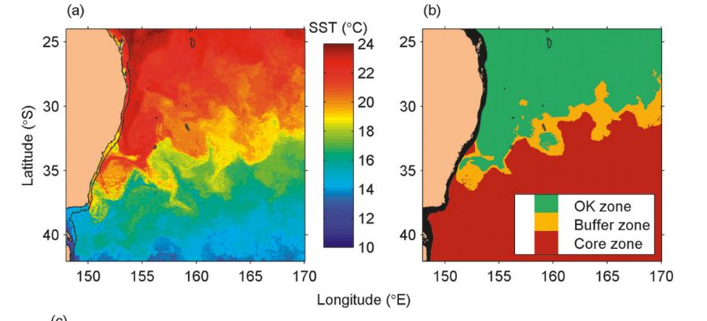
Incorporating uncertainty into maps
Use of Forecast Index
Forecast of a) Sea Surface Temperature (SST) which is converted into a forecast of b) habitat suitability for southern bluefish tuna
No Uncertainty With Uncertainty
Forecast output Forecast Index
Figure: Hobday et al. 2011
Notes:
Another way to incorporate uncertainty is to translate a forecast output without uncertainty into a forecast index. Here, researchers have done this by taking a forecast of Sea Surface Temperature on the left, and converting that into a forecast index based on what scientists know about what water temperatures southern bluefish tuna like to live in. The forecast index on the right now represents uncertainty by showing which areas are more likely to have bluefish tuna. The goal of this forecast is to reduce the amount of bycatch of bluefish tuna for fisherman who are fishing for other species.
The “OK zone” refers to the zone where bluefish tuna are not likely to be found and is “OK for fishing without restrictions” to avoid bycatch of bluefish tuna. The “core zone” represents areas of prime suitability for bluefish tuna where they are most likely to be found in large numbers and should not be fished without restrictions. Buffer zone refers to an intermediate region (buffer habitat), where it is possible to find bluefish tuna but less likely than in the core zone.

Slide 25

How do forecast visualizations influence decision-making?
Visualizations can be critical in helping forecast users understand forecasts
However, the way uncertainty is represented has an influence on how people make decisions
Considering decision needs of a forecast user can help improve the usefulness of the visualization
Pixabay
PikRepo
Ramos et al. 2014, Cheong et al. 2016
Notes:
And so does it matter how we communicate forecast output? We know that visualizations can be critical in helping forecast users understand forecast output. However, the way uncertainty is represented has a proven an influence on how people make decisions (e.g., Ramos et al. 2014, Cheong et al. 2016). Which means that considering decision needs of a forecast user can help improve the usefulness of the visualization

Slide 26

Our focal question:
How can ecological forecasts and their visualizations aid in decision-making?
Image: WVWA
Notes:
Today’s focal question is ‘How can ecological forecasts and their visualizations aid in decision-making?’

Slide 27
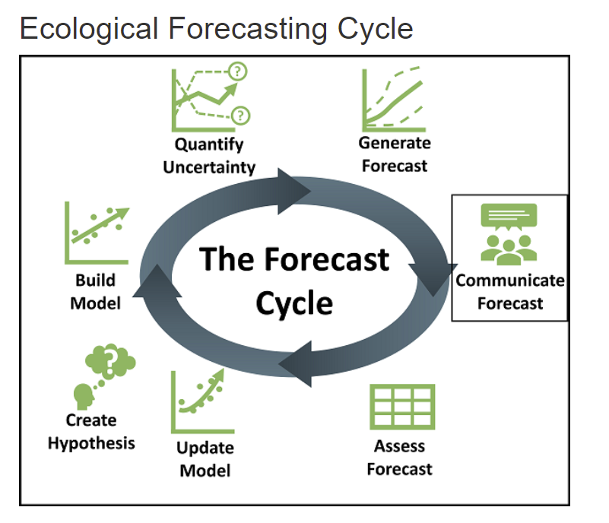
Learning objectives
Describe what ecological forecasts are and how they are used
Identify the components of a structured decision
Discuss how forecast uncertainty relates to decision-making
Match forecast user needs with forecasting decision support
Identify different ways to represent uncertainty in a visualization
Create visualizations tailored to specific forecast users
Notes:
Learning objectives!
Talk through these with the students one by one: use the embedded animations to sequentially show each of the bullet points.
Most importantly, the goal here is to have students develop their own hypotheses for how decision-making can be influenced by forecast uncertainty

Slide 28
Three ways to run this module
Recommended method: Shiny app website: https://macrosystemseddie.shinyapps.io/module8/
Will time out after 15 minutes, so important to save your work as you go!
Download and run the app locally from GitHub: https://github.com/MacrosystemsEDDIE/module8
Initial download requires internet but then can run module offline
Need R and R Studio installed
Binder website: https://mybinder.org/v2/zenodo/10.5281/zenodo.7074674/?urlpath=shiny/app/
Cannot support many simultaneous users
Regardless of which method you use, all options will give you the same module activities!
Notes:
The instructor may want to edit this slide beforehand if they’ve decided how they wants students to access the module and to ensure that students use the correct method

Slide 29

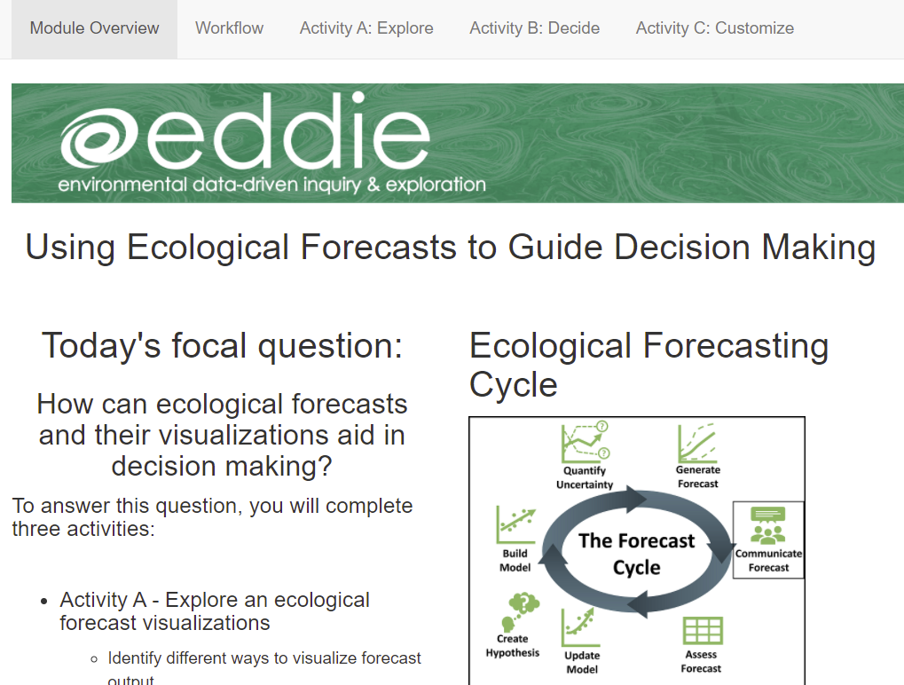
Shiny App
The module can be accessed at: https://macrosystemseddie.shinyapps.io/module8/
This is an interactive webpage built using R
It has interactive plots and embedded options which allow you to make decisions using forecast output, and answer questions
Notes:
Shiny App:
The module can be accessed at: https://macrosystemseddie.shinyapps.io/module8/
This is an interactive webpage built using R code
It has interactive plots and embedded options which allow you to make decisions using forecast output, and answer questions

Slide 30
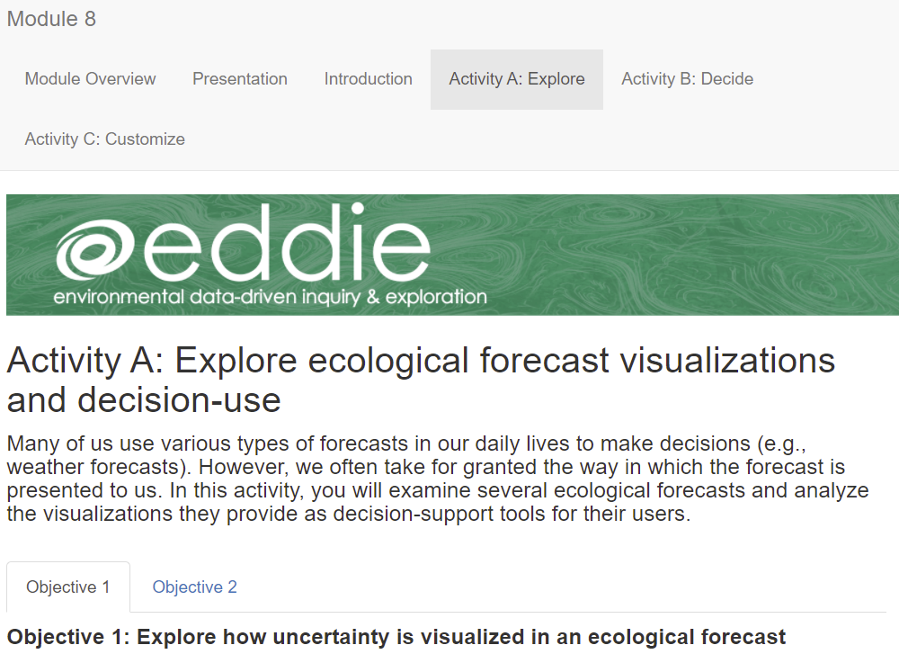
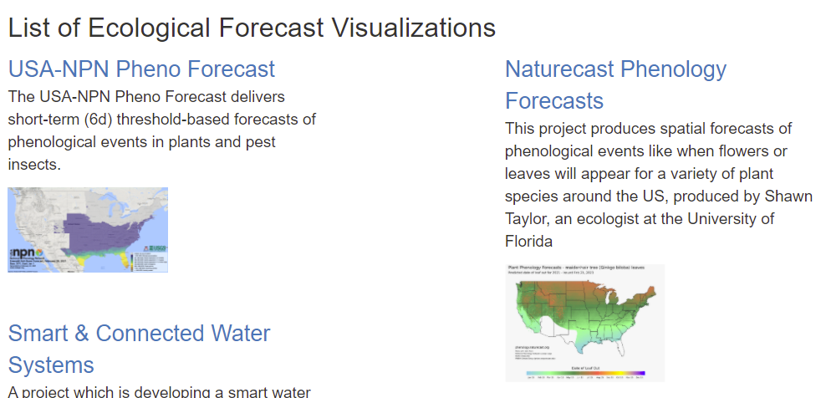
Activity A: Explore an ecological forecast
Within the Module 8 Shiny App, work in pairs:
Choose an ecological forecast visualization to analyze
Compare your forecast with your partner to analyze in Objective 2
Save your answers within the Shiny App using the ‘Download user input’ button at the bottom of the app!
Notes:
Introduce Activity A, which has 2 objectives:
Familiarize yourself with an ecological forecast by identifying the basic components of a forecast, forecast application and forecast users, and how forecasts are visualized
Compare forecasting systems to see how ecological forecasts can vary among ecosystems or ecological variables
The main take home here is that students will be analyzing forecast visualization and comparing between different visualizations.
Have students work in pairs as described earlier.
After you’ve introduced the steps of Activity A, stop the PowerPoint and let the students get started on Activity A.

Slide 31
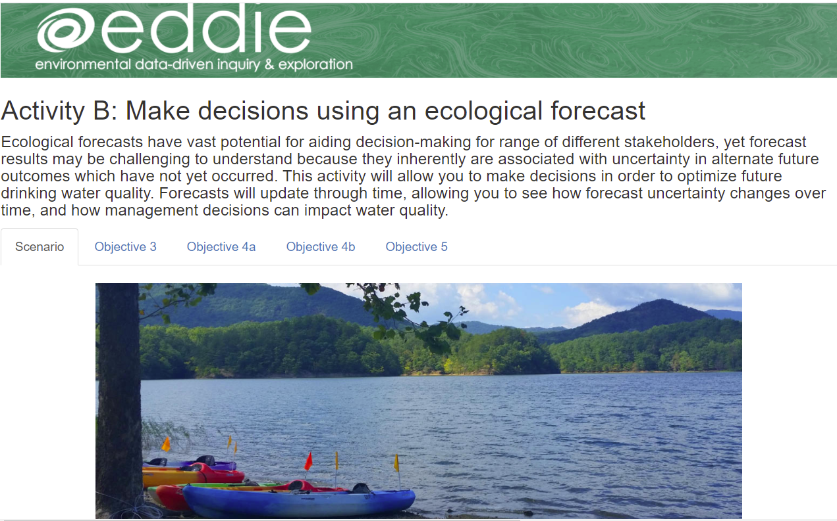
Activity B: Make decisions using an ecological forecast
Identify the factors affecting your decision in Objective 3
Make decisions with two different visualizations in Objective 4a and 4b
Discuss forecast uncertainty and your decisions in Objective 5
Save your answers within the Shiny App using the ‘Download user input’ button at the bottom of the app!
Notes:
Introduce Activity B, which has three objectives:
The important take-home message here is that students need to 1) first examine the decision they will make as a drinking water manager, 2) make decisions using two different types of visualizations, one which includes uncertainty and one which does not, and 3) answer questions and explore ideas around how the visualizations influenced their decision-making and how uncertainty changed over time.

Slide 32
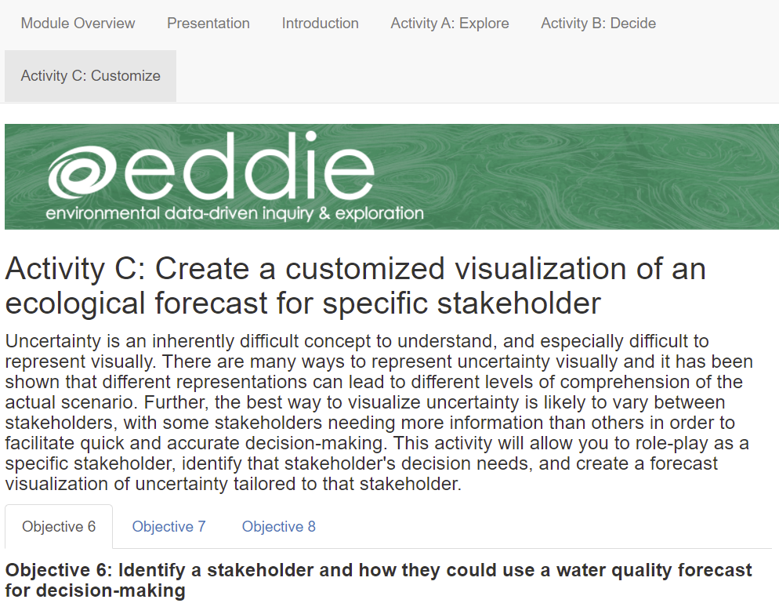
Activity C: Create a customized visualization for a specific forecast user
Choose a forecast user in Objective 6
Get to know your forecast output in Objective 7
Create a customized visualization for your forecast user in Objective 8
Save your answers within the Shiny App using the ‘Download user input’ button at the bottom of the app!
Notes:
Introduce Activity C., which has 3 objectives:
The main take home for this activity is that students will 1) pick a forecast user of their choosing and identify a decision their forecast user needs to make, 2) explore the forecast output which makes up their data, 3) create a visualization within the app that is tailored to their forecast user’s needs, and 4) explain why they chose that visualization and how a different forecast user may or may not need the same visualization.

Slide 33
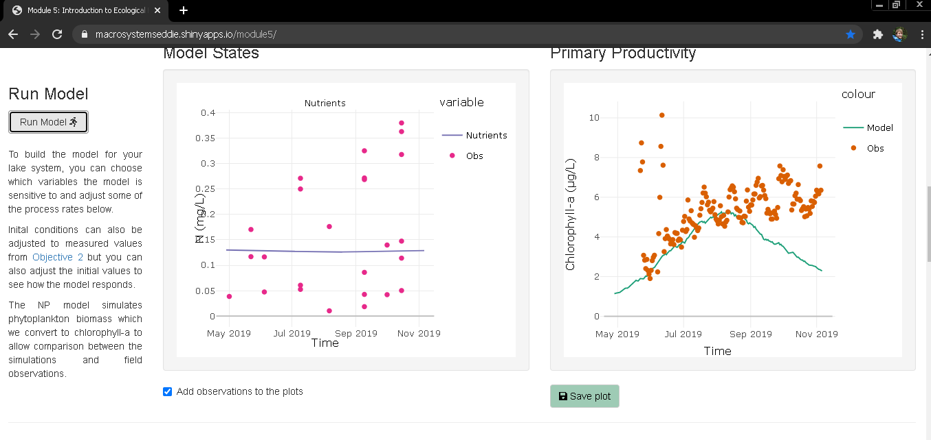

Saving plots
Save plots for downloading with your final report

Slide 34
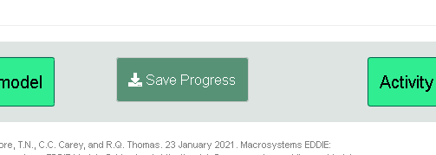
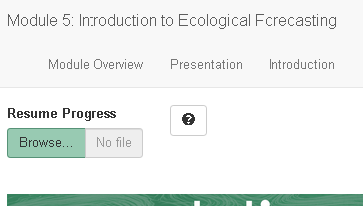
Saving & Resuming Progress
Saving Progress
Scroll to bottom of the page
Click on the “Save Progress” button. An ‘.eddie’ file will download. Your computer might prompt you to open this in R. This will not work, it only works for uploading to the Shiny app
Store this file somewhere safe on your computer
Resuming progress
Scroll to the top of the page
Upload the ‘.eddie’ file
This will populate your saved text answers and saved parameters

Slide 35
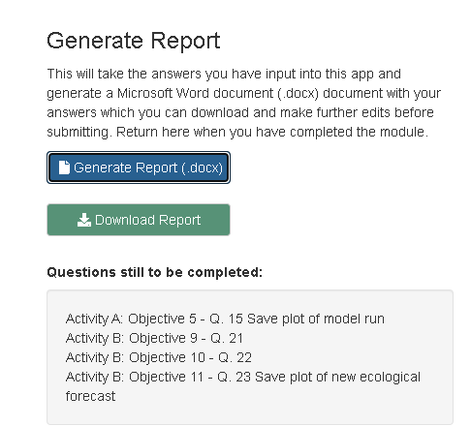
Downloading the Report
Navigate to the “Introduction” tab
Scroll down to “Save your progress” section
Click on the “Generate Report (.docx)” button.
Then the “Download Report” button will appear. Click this to download the report with answer and plots embedded within a Word document to your computer.
Notes:
Generating the student report.
Stop the presentation here and navigate to the Shiny App while screen sharing.
Briefly demonstrate how to navigate between Activity Tabs and objective tabs within each Activity.
Demonstrate the buttons regarding saving your progress and resuming your progress and the “Generate Report” feature.
Make sure to emphasize to students to read through the text carefully as there are instructions there if they get confused. Also encourage them to feel free to ask questions if they don’t understand what to do.
At this point send the students into breakout rooms of ~4 (2 pairs each) and let them get started on the Shiny App.
Identify if the saved report will be submitted as an assignment and which app questions need to be completed as part of the activity.

Slide 36
Let’s Go!
We will work in pairs throughout the three activities.
Both members of the pair select different visualizations in Activity A and can help each other go through the objectives
For virtual instruction, we will breakout into rooms of four students, so you can consult the other pair of students, too!
For face-to-face instruction, students can arrange themselves in groups of four to a table!
https://macrosystemseddie.shinyapps.io/module8/

Slide 37
Presentation of Forecast User Visualizations
Notes:
As a culminating check-in, ask students to justify why they have developed their visualizations for their forecast users.
Finally, challenge them to think about how co-development with an actual forecast user might influence and improve their visualizations. Ask them to consider how iterative design of visualizations can aid in usability for decision-making.

Slide 38
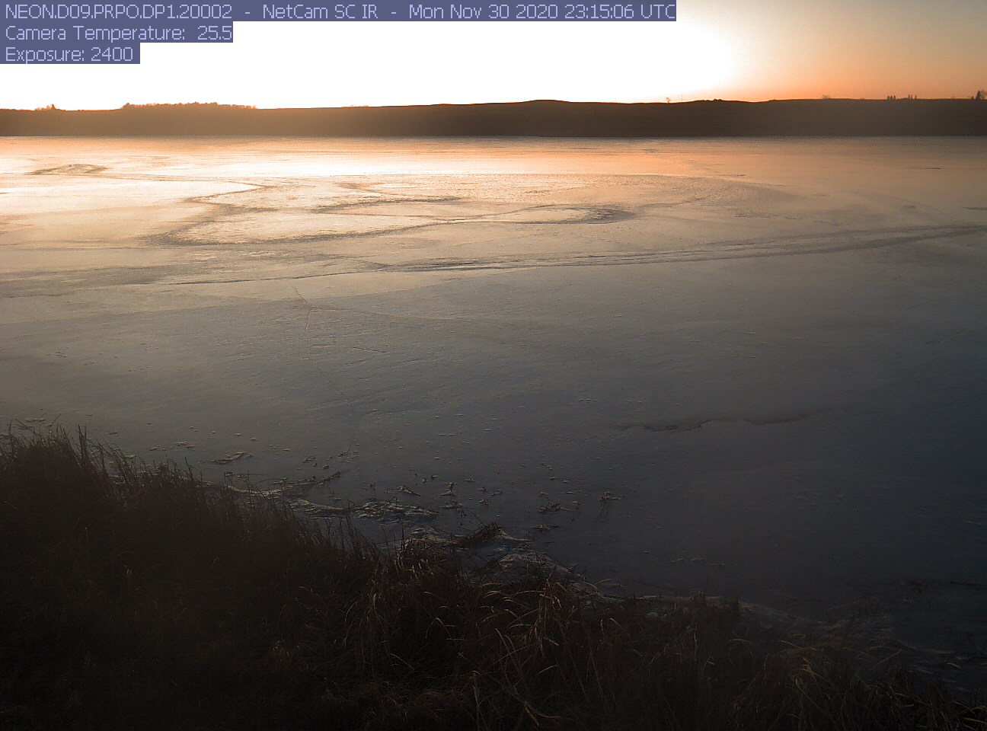

Thank you for participating!
Check out our other modules:
Intro to Ecological Forecasting—Module 5
Uncertainty – Module 6
Model-Data Fusion – Module 7
Find out more at: macrosystemsEDDIE.org

Slide 39
Optional additional slides
Depending on your class and the time available, you may want to include some of the following slides for discussion of the module concepts
Notes:
Depending on your class and the time available, you may want to include some of the following slides for discussion of the module concepts:

Slide 40
How can ecological forecasts be used in decision-making?
Forecasts can facilitate structured decision-making, or a formal method of analyzing decisions
Problem clearly define why a decision needs to be made
Objectives determine the specific goals associated with your problem
Alternative decisions consider alternate decision scenarios
Consequences identify the consequences of an alternative decision on each objective
Trade-Offs evaluate the tradeoffs between your objectives to see the benefits of different alternative decisions. This step combines the effect of multiple consequences.
Notes:
In order to use an ecological forecast to make decisions, you first need to identify the decision at hand. Often times, these decisions are quite complex and laden with consequences. PrOACT helps us to break down complex situations in order to make more effective and organized decisions. First you identify the problem, why does a decision need to be made?

Slide 41
How can ecological forecasts be used in decision-making?
A forecast of the timing of peak gypsy moth occurrence could help homeowners make decisions about how to protect trees on their property.
Problem as a homeowner, you want to protect your native vegetation from invasive gypsy moth
Objectives maximize oak tree growth
Alternative decisions apply insecticides
Consequences other native insects may die from insecticide application
Trade-Offs native insect populations may
decrease but gypsy moth populations remain low
and tree health is optimized
Wikimedia Commons
Notes:
In order to use an ecological forecast to make decisions, you first need to identify the decision at hand. Often times, these decisions are quite complex and laden with consequences. PrOACT helps us to break down complex situations in order to make more effective and organized decisions. First you identify the problem, which is the trigger for why you are making a decision. Next, you identify your specific objective. This step is important is determining what outcome exactly you would like from your decision. For example, while you may successfully decrease gypsy moth abundance through making a decision, the actual objective is the maximize the growth of trees in your yard

Slide 42
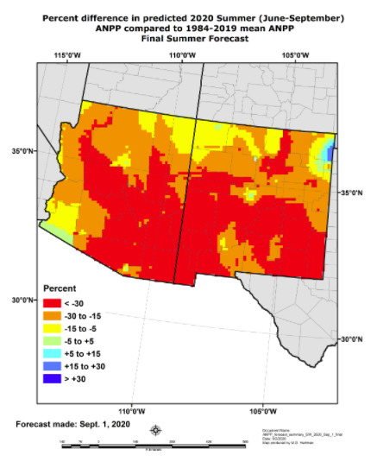
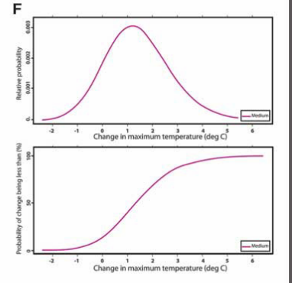
More examples of uncertainty visualizations
Summary based on a metric
Probability distribution of raw data
Notes:
https://grasscast.unl.edu/

Slide 43
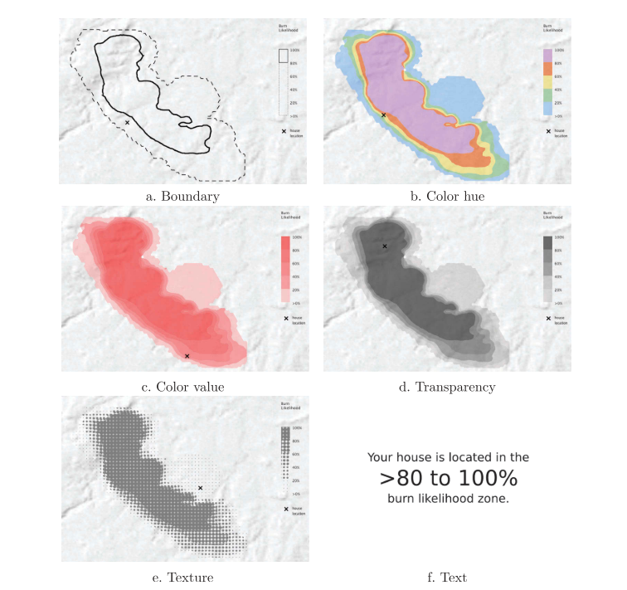
User preference does not always indicate the most effective visualization
Users were asked to stay or leave their home given one of these scenarios. This was then weighed against an observed outcome.
Most users preferred the color hue representation
However, users performed best with the simplistic text scenario
Cheong et al. 2016
Notes:
Maybe only have this slide as bonus? It seems like a lot to go through and might introduce more confusion

